Slide 1

GROCERY STORE MANAGEMENT
Presented By
Tharun Kumar Marati
Batch No. 442
Innomatics Research Labs,
Dilsukhnagar

Slide 2
About me
I am a recently completed Bachelor of Technology in Computer Science and Engineering (CSE).
I am Passionate about analyzing data to solve real-world problems and enhance decision-making.
LinkedIn: http://www.linkedin.com/in/marati-tharun-kumar
GitHub: https://github.com/Tharunkumarmarati

Slide 3
Agenda
Problem Statement
Objective of the Project
ER Diagram and schema explanation
Key analysis questions (use cases)
SQL query results with screenshots
Final business insights and recommendations
Challenges working on SQL – Data Analysis Project.
Conclusion
Q&A Slide

Slide 4
Problem Statement
Managing grocery store operations manually leads to challenges such as inconsistent data entry, loss of records, difficulty in tracking sales, and lack of accurate reporting. With increasing customer transactions and product variations, manual management becomes inefficient and error-prone. There is a need for a computerized database system that automates operations, ensures accuracy, and offers quick access to essential information. The Grocery Store Management System aims to provide a reliable database solution to address these challenges by organizing all operational data into a unified system.

Slide 5
Objective of the Project
1. To design a structured database for managing grocery store operations efficiently.
2. To simplify the tracking of products, categories, and suppliers.
3. To manage customer and order information systematically.
4. To analyze sales through order and revenue reporting.
5. To improve decision-making with data insights.
6. To ensure accurate transaction handling using order and order_details tables.
7. To apply SQL concepts such as joins, constraints, grouping, and aggregate functions.
8. To automate and streamline store management processes.

Slide 6
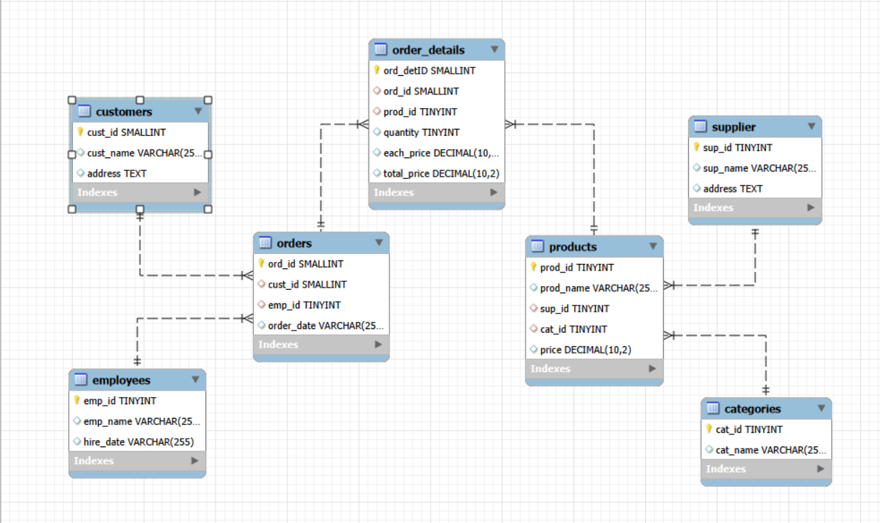
ER Diagram

Slide 7
Database Schema
The database schema for the Grocery Store Management System is designed using a fully relational structure that organizes all key components of the store into seven interconnected tables - customers, employees, suppliers, categories, products, orders, and order_details.
Each table represents a specific entity, and relationships are maintained through primary and foreign keys to ensure data integrity and eliminate redundancy.
Customers and employees link to the orders they place or process, while products are connected to their respective suppliers and categories for proper classification.
The order_details table captures item-level purchase information, enabling accurate billing and detailed sales analysis. Overall, the schema provides a clear, efficient, and scalable structure for managing store operations and supporting analytical queries.

Slide 8
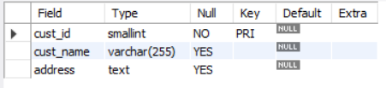
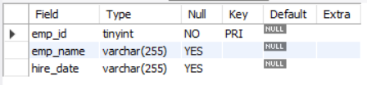

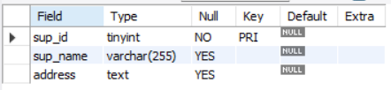
Tables
Customer Table
Employee Table
Category Table
Supplier Table

Slide 9
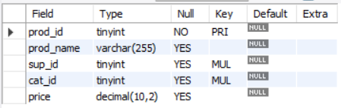
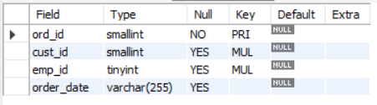
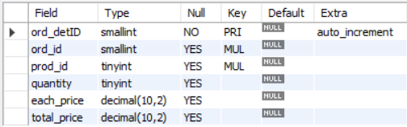
Products Table
Orders Table
Order_details

Slide 10
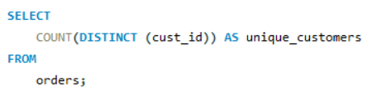

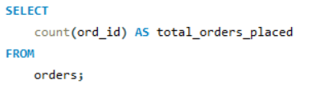

Key analysis questions
How many unique customers have placed orders?
How many orders have been placed in total?

Slide 11
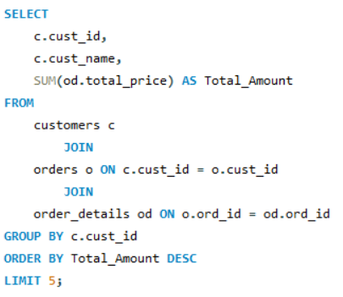
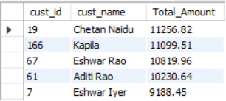
Who are the top 5 customers by total purchase amount?

Slide 12
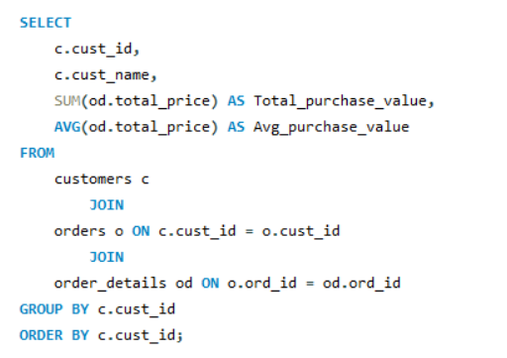
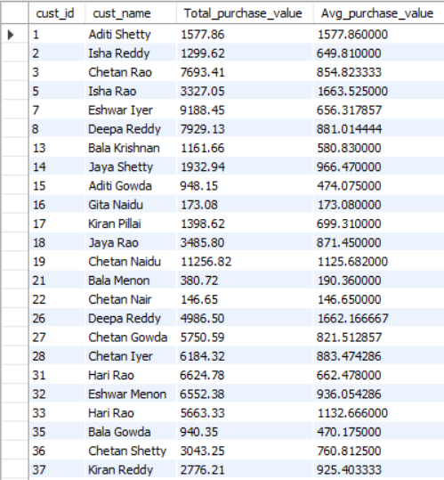
What is the total and average purchase value per customer?

Slide 13
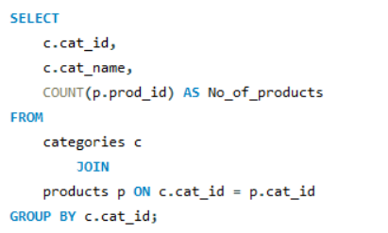
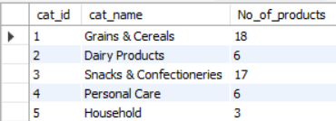
How many products exist in each category?

Slide 14
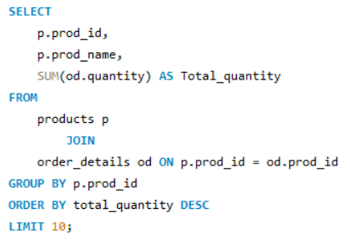
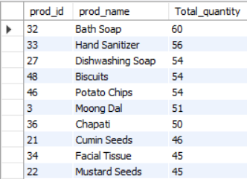
Which products have the highest total sales volume (by quantity)?

Slide 15
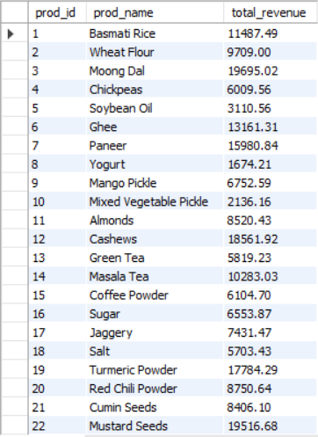
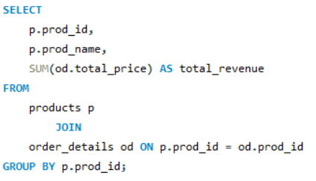
What is the total revenue generated by each product?

Slide 16
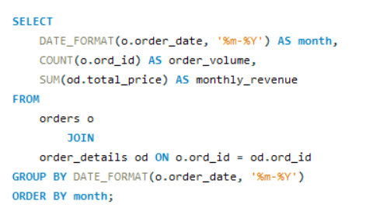
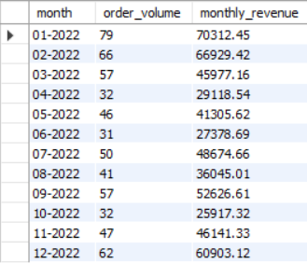
What are the monthly trends in order volume and revenue?

Slide 17
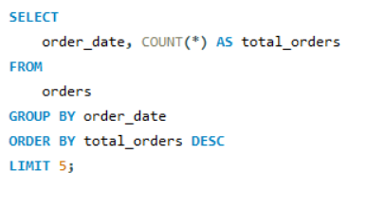
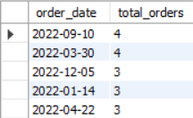
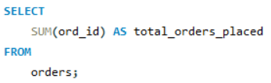

On which dates were the most orders placed?
How many orders have been placed in total?

Slide 18

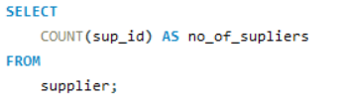
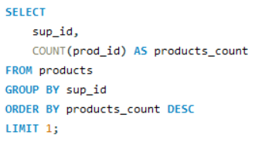

How many suppliers are there in the database?
Which supplier provides the most products?

Slide 19
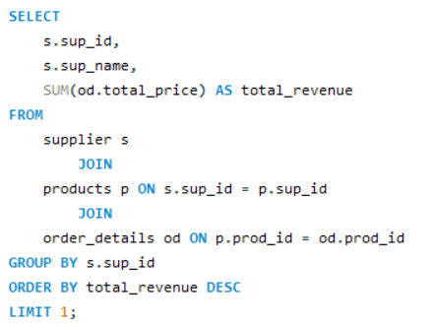

Which supplier contribute the most to total product sales (by revenue)?

Slide 20
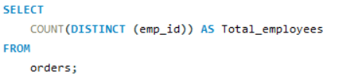

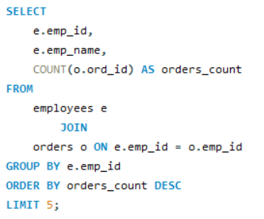
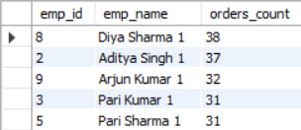
How many employees have processed orders?
Which employees have handled the most orders?

Slide 21
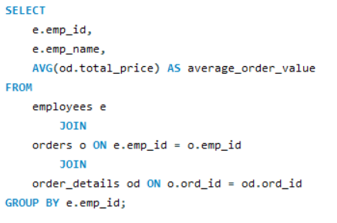
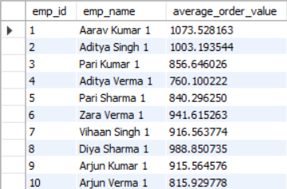
What is the average order value handled per employee?

Slide 22
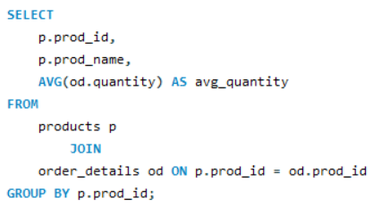
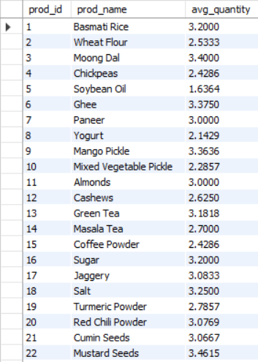
What is the average quantity ordered per product?

Slide 23
Final Business Insights
Product Performance: A few products generate most revenue, while some items sell very little due to low demand or visibility.
Customer Behavior: Repeat customers drive major sales, and weekend shopping is consistently higher.
Sales Trends: Orders rise during weekends ; average order value is gradually increasing.
Pricing & Profitability: Some items are profitable but low-volume; discounts boost sales but may lower margins.

Slide 24
Key Recommendations
Product Strategy: Focus on top-selling items and improve visibility of slow-moving products through bundling or re-pricing.
Customer Strategy: Strengthen loyalty programs and target weekend shoppers with personalized offers.
Sales Growth: Run promotions during known peak periods and encourage cross-selling.
Operations: Improve inventory forecasting and identify and remove those slowdown or obstacles in order processing.
Profit Strategy: Adjust pricing for low-demand items, use discounts smartly, and promote bundle deals to increase revenue.

Slide 25
Challenges Faced During the SQL – Data Analysis Project
One of the main challenges we faced was ensuring data consistency.Especially converting string-based dates into proper SQL date formats. Another challenge was optimizing aggregation queries to avoid incorrect results caused by missing relationships or grouping errors. Interpreting the analytical output and converting it into meaningful business insights also required careful thinking. Overall, the project improved my SQL problem-solving skills and gave me practical exposure to end-to-end data analysis in a business scenario.

Slide 26
Conclusion
The Grocery Store Management System successfully organizes core store operations in a structured and efficient manner. By using MySQL, the project provides a robust solution for managing customers, products, suppliers, employees, and transactional records. The analytical queries included in the system allow the store owner to understand sales performance, customer trends, and product profitability. Overall, the system enhances data accuracy, improves operational efficiency, and supports informed decision-making. It serves as a strong foundation for developing a full-fledged inventory or billing application in the future.

Slide 27

THANK YOU

